Slide 1
Deep learning: The Schrödinger Equation
Brandon Brisbane | Meetinder lail | Daniel CHelso | rubin hazarika

Slide 2

Introduction
Big picture: solving the 'electronic structure problem’ – how do electrons behave in a potential?
Computationally intensive to compute solutions by solving various differential equations – difficulty scales with molecule size
Can we learn properties of the state system using neural networks?
Notes:
- We want to understand and solve, computationally, the electric structure problem – how do electrons behave in electric field generated by atomic nucluei
- Thus, we need to understand the quantum state involved in the interactions and need to model the states using the Schrodinger equation; this equation models the evolution of a state psi using the energy operator (the Hamiltonian)
- So, as an alternative to solving various partial differential equations, can we use neural networks to identify the defining features of a quantum system without needless calculations

Slide 3
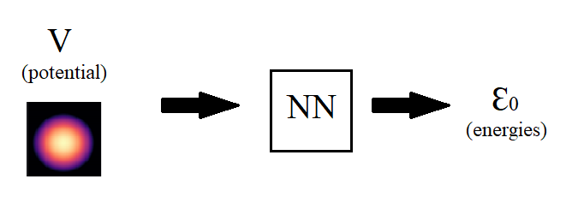
The target problem
Specific system: one electron in a confining potential – identify energy eigenstates of system
Algorithms presented here make use of "featureless learning" to circumvent problems
Scalability
Feature-specific learning
Limited atomic models
Notes:
- Now, this paper targets one specific system, given a single electron in a confining potential, can we identify the energy eigenstates of the system : can we find E0, E1, etc.
- The system can be modelled by the time independent Schrodinger equation where the Hamiltonian H is an operator that describes the potential and kinetic energies of the system
- There are algorithm that aim to address the computational difficulties using machine learning algorithms

Slide 4
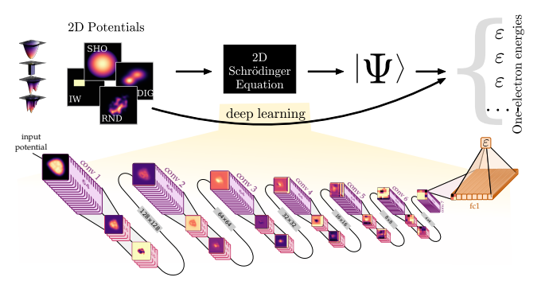
Methodology
Takes potential distribution and turns into images
Run a CNN on the data
Repeated convolutional layers used
12 layers, each of which adds training parameters
Final convolutional layer feeds into fully connected final layer with single output
Used to compute mean-squared loss value
Results in eigenvalues and energy levels for the system
Notes:
ReLU = Rectified Linear Unit
CNN = Convolutional Neural Network
Layers chosen for speed an accuracy, all layers have ReLU activation
12 layers, 7 reducing, 5 non reducing
Reducing layers are 3x3 pixels in width, 64 filters, and 2x2 stride to reduce image size by factor of 2
Non-reducing are 16 filters with 4x4 size, used to preserve image resolution
Final layer of width 1024
1000 epochs for no loss decrease

Slide 5
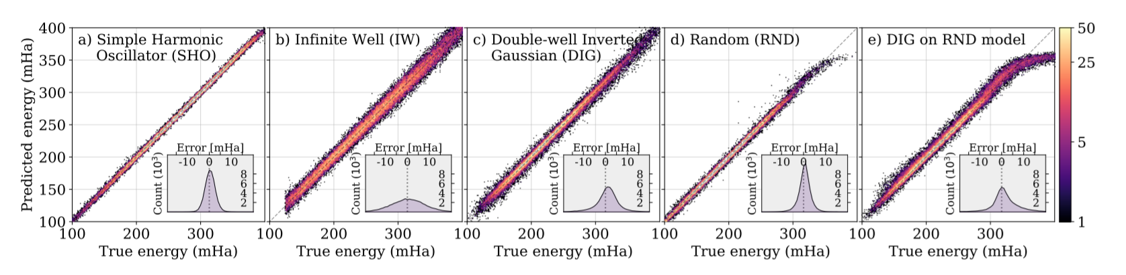
Summary of experimental results
Below are the graphs that were obtained for simple harmonic oscillator, infinite well, double well inverted gaussian and the randomly generated potentials.

Slide 6
SUMMARY OF EXPERIMENTAL RESULTS
Cases | Median Absolute Error (MAE)
Simple harmonic oscillator | 1.51 mHA
Infinite Well | 5.04 mHA
Gaussian Potentials | 2.70 mHA
Random Potentials | 2.13 mHA
Additoinal 200,000 samples, 1000 epochs | 1.49 mHA
Random Class on Gaussian Data | 2.94 mHA
A model trained on all four classes | 5.90 mHA
200,000 samples and 1000 epochs were added
Random potentials did not perform well at higher energies
Finally, a model was trained on all four classes of potentials, which has a MAE of 5.90 mHA

Slide 7
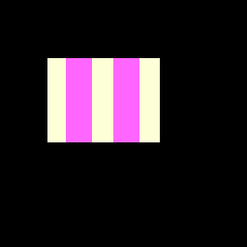

Our Project
Goal
Recreate the results for the haramonic ocsillator and infinite well potentials
Create results for "gradient well" and "double barriar" potentials
Attempt to use new results to train a model better at solving "well type" (discontinuous potentials) cases
Gradient Well
Double Barriar Well
Notes:
- Goal
- Recreate the results for HO and ISW classes
- Create results for GW (electric potential on ISW) and DB (like resonant tunneling diode)
- Try use new results to improve IW type potential performance
- Includes validating on potential different from the training potential and mixed train datasets
- Data
- Same method as detailed in paper
- Generate potentials with known functions, translate to heatmap matrix
- Use potential fuction to find ground state energy via zero finding
- Challenges
- number of samples required (200,000) per potential class
- getting discontinuous potentals to preform well

Slide 8
Our project
Roadmap
Stage 1: Generate potential heatmaps and ground state energies
Stage 2: Build CNN; test on reduced set of harmonic ocillator potentials
Stage 3: Generate results for potentials from paper; fine tune network
Stage 4: Generate reults for new potentials, collect full set of results
*Each stage is expected to take 4-7 days to complete

